Slide 1
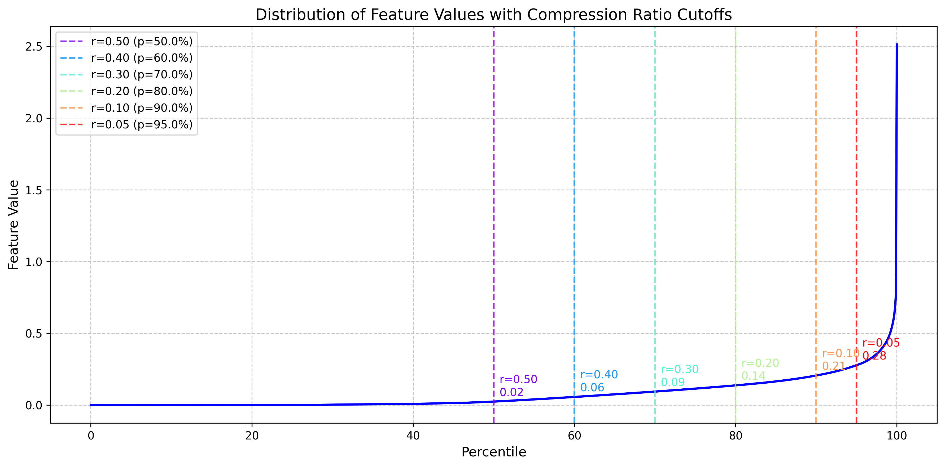
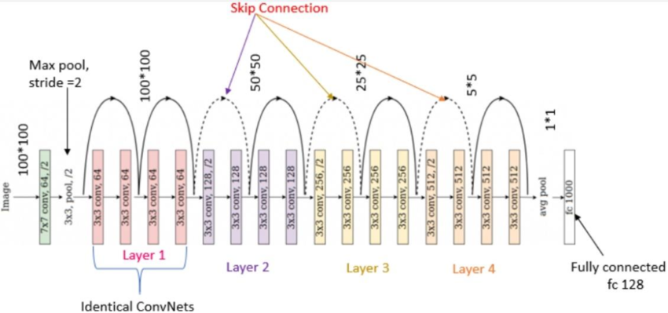

Slide 3
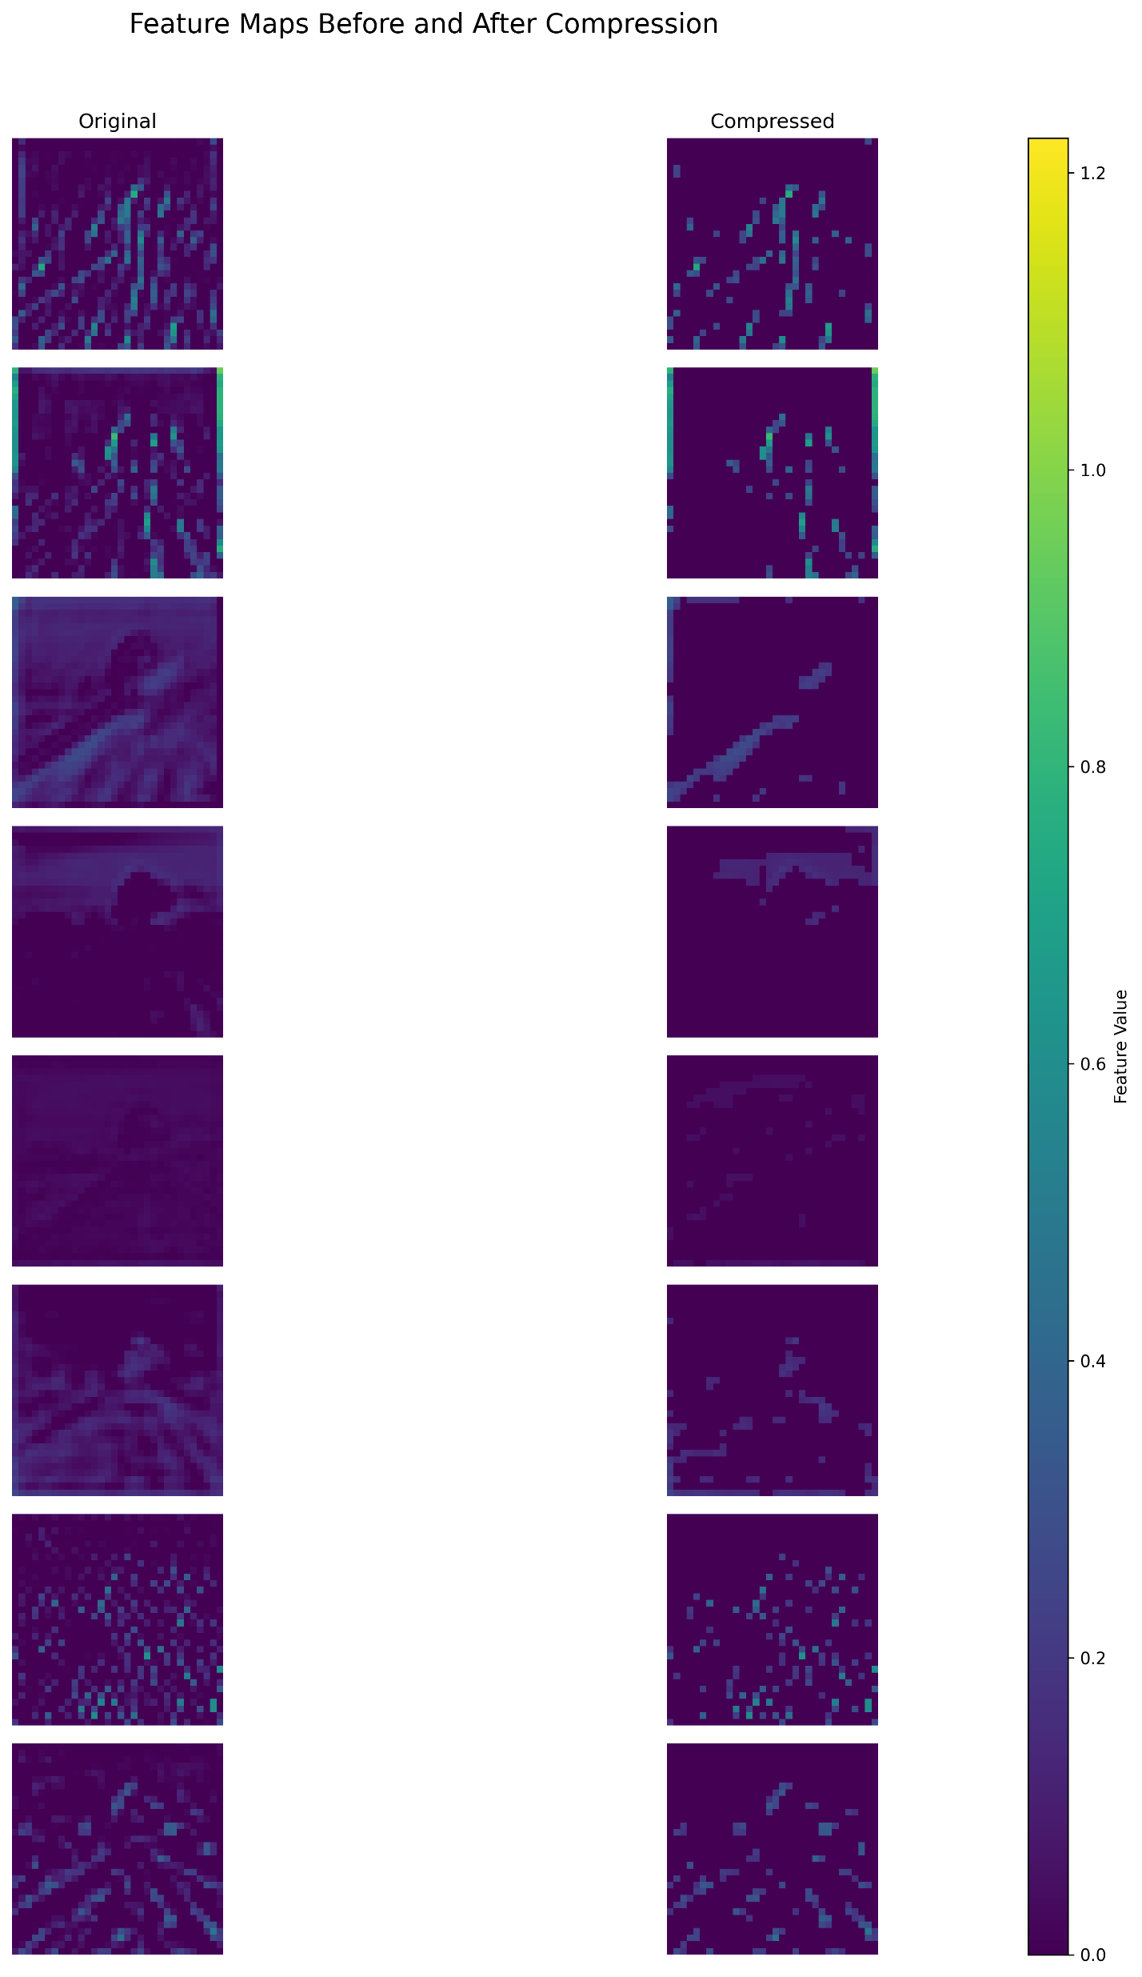
Features are sparse
Sparse representation to represent the larger feature values
Top K method to select the important features
Fine tuning of remaining layers

Slide 6
Dataset

Slide 7
Channel Wise TopK or not
Fine tuning
Actual bpp
Not all high value ones are important, most may be redundant

Slide 8
Indices: Delta + Run length/Huffman encode
Values: Huffman encode
Sparse
Block energy sparse
Channel-wise
Region-wise
Global
Ignore border or not

Slide 9
Block-based Tiny Feature Codec

Slide 10
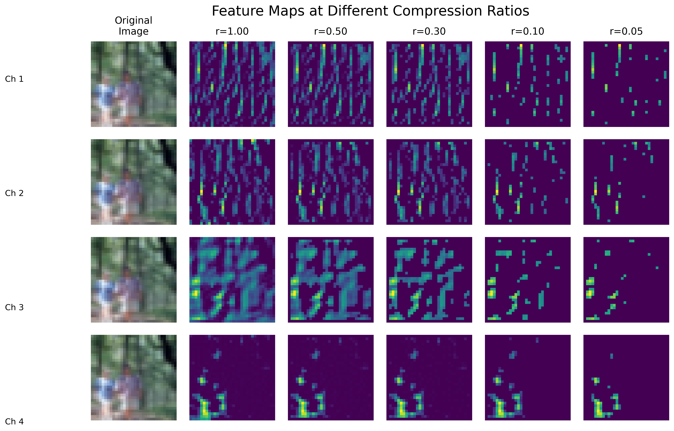

Slide 11
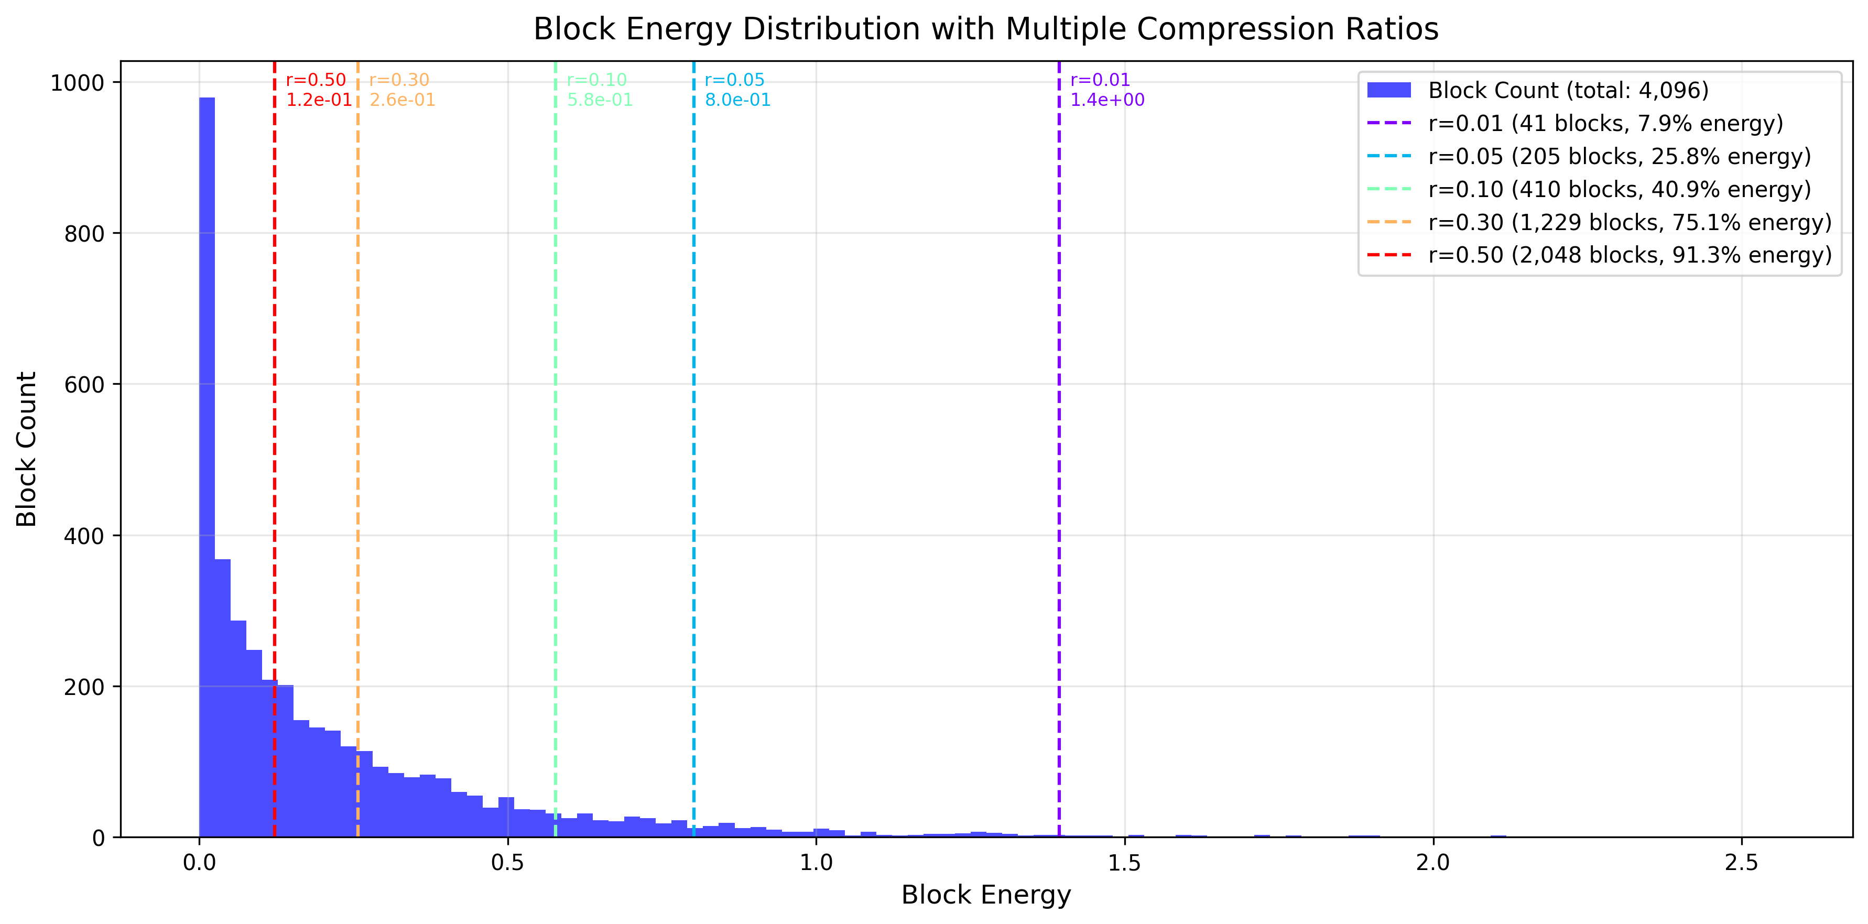

Slide 12
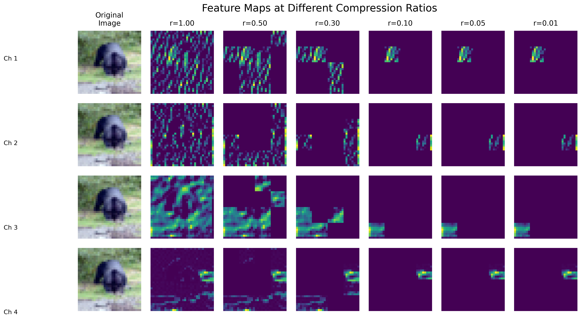

Slide 13
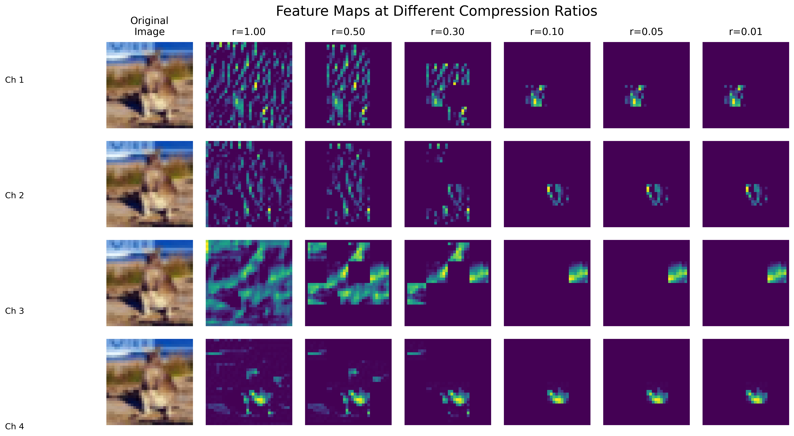

Slide 14
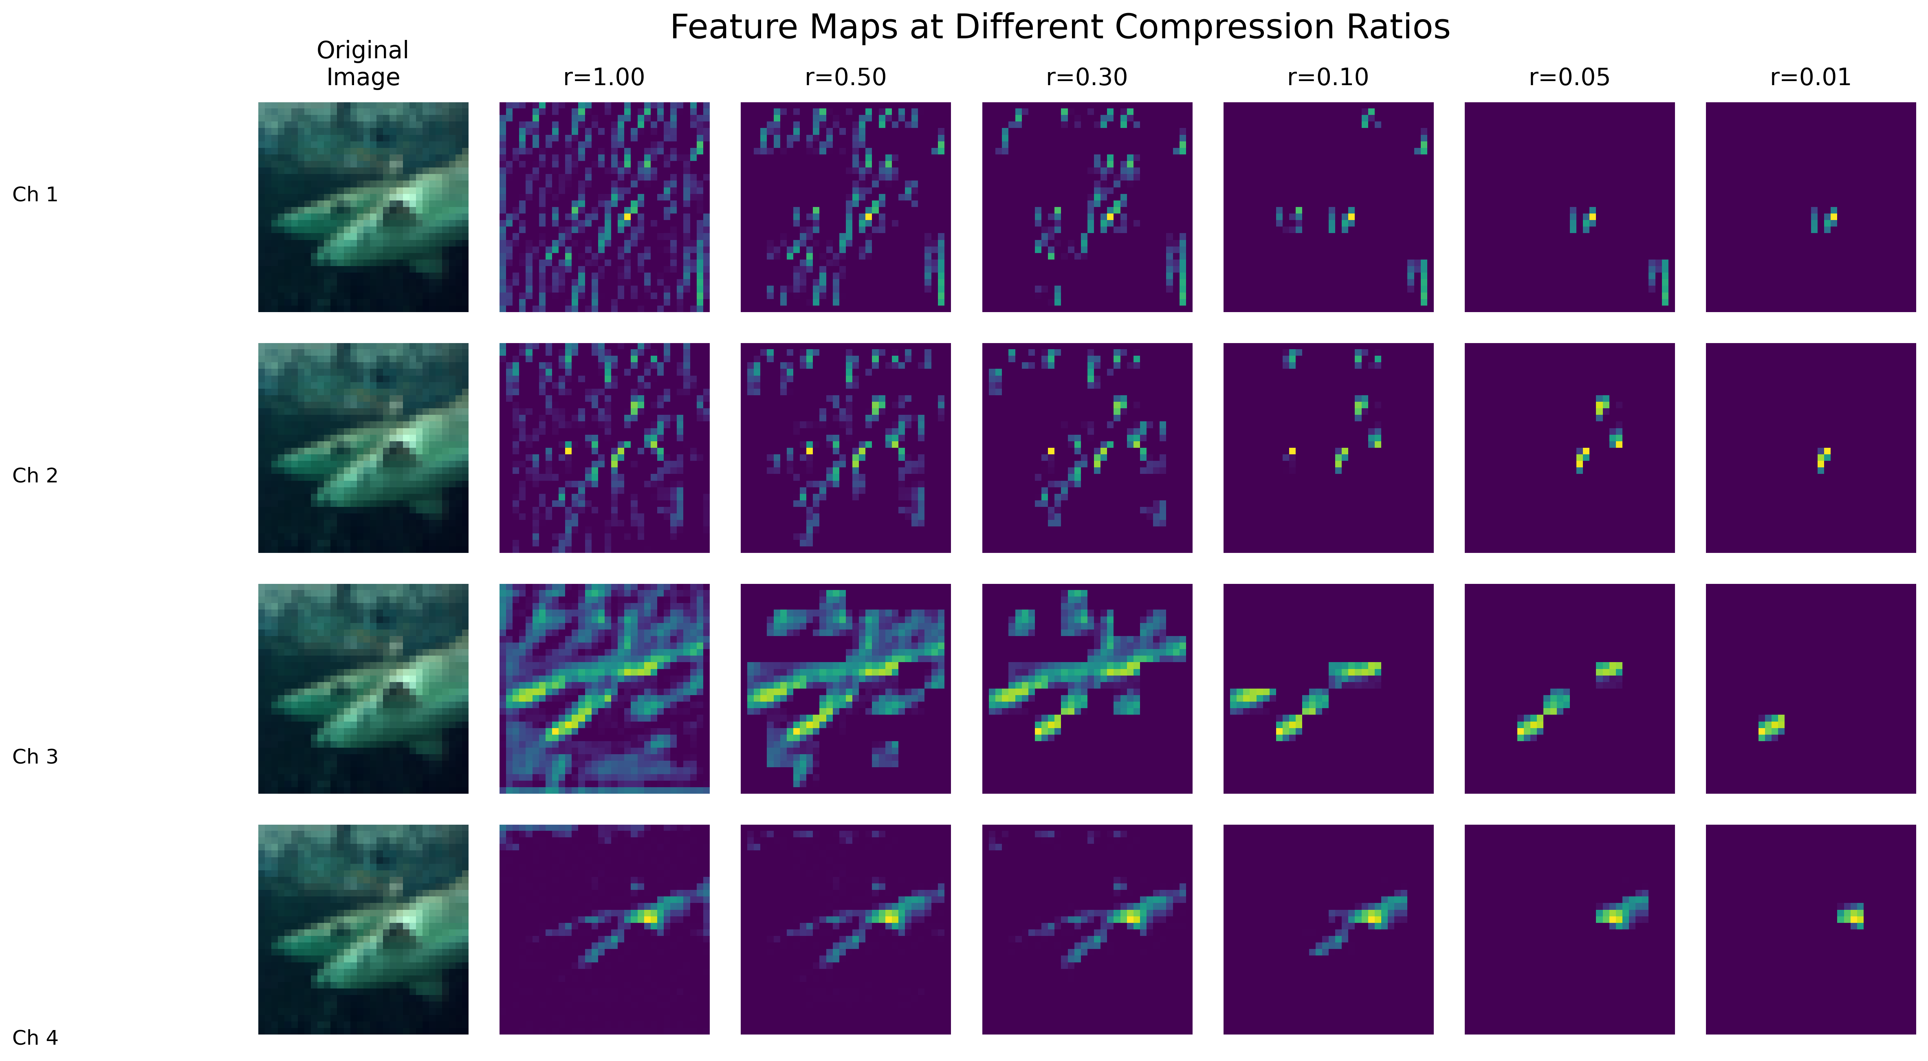

Slide 15
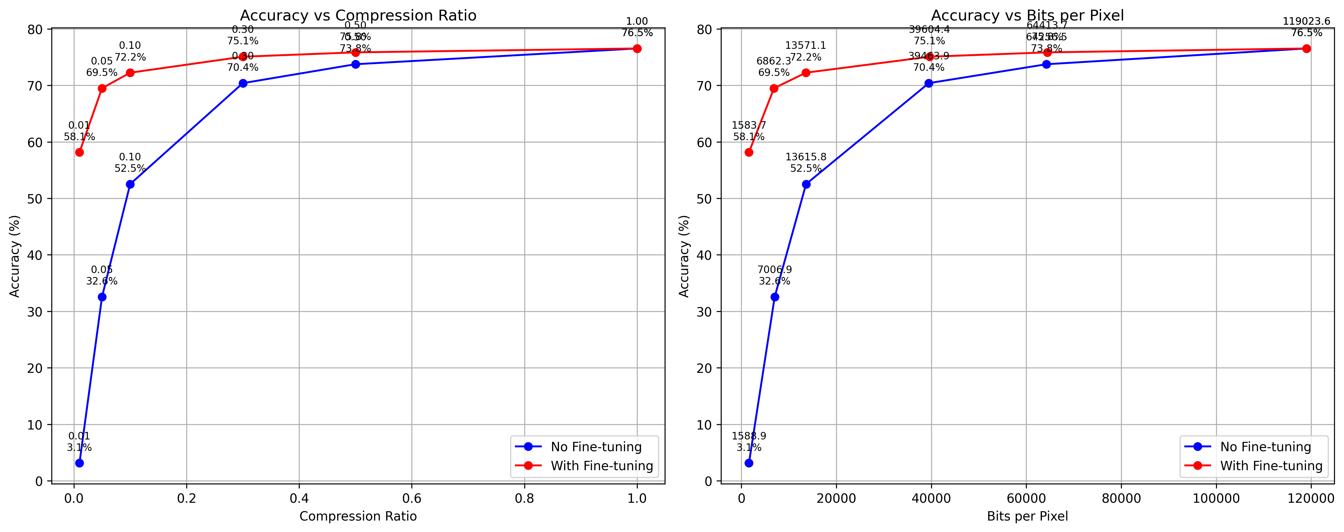

Slide 16
Channel | Row | Column | Value
0 | 0 | 0 | 0.14
0 | 0 | 0 | 0.25
0 | 0 | 1 | 0.52
0 | 0 | 1 | -0.12
0 | 1 | 0 | 0.45
0 | 1 | 0 | 1.20
0 | 1 | 1 | -0.62
0 | 1 | 1 | 0.54
0 | 2 | 0 | -0.23
0 | 2 | 0 | 0.12
0 | 2 | 1 | 0.76
0 | 2 | 1 | -0.42
1 | 0 | 0 | -2.1
1 | 0 | 0 | 0.39
… | … | … | …

Slide 17
Channel | Row | Column | Value
0 x 12 | 0 x 4 | 0 x 2 | 0.14
 |  |  | 0.25
 |  | 1 x 2 | 0.52
 |  |  | -0.12
 | 1 x 4 | 0 x 2 | 0.45
 |  |  | 1.20
 |  | 1 x 2 | -0.62
 |  |  | 0.54
 | 2 x 4 | 0 x 2 | -0.23
 |  |  | 0.12
 |  | 1 x 2 | 0.76
 |  |  | -0.42
1 x 12 | 0 x 4 | 0 x 2 | -2.1
 |  |  | 0.39
… | … | … | …

Slide 18
Channel | Row | Column | Value
0 | 0 | 0 | 0.14
0 | 0 | 0 | 0.25
0 | 0 | 1 | 0.52
0 | 0 | 1 | -0.12
0 | 1 | 0 | 0.45
0 | 1 | 0 | 1.20
0 | 1 | 1 | -0.62
0 | 1 | 1 | 0.54
0 | 2 | 0 | -0.23
0 | 2 | 0 | 0.12
0 | 2 | 1 | 0.76
0 | 2 | 1 | -0.42
1 | 0 | 0 | -2.1
1 | 0 | 0 | 0.39
… | … | … | …

Slide 19
Channel | Row | Column | Value
0 | 0 | 0 | 0.14
0 | 0 | 0 | 0.25
0 | 0 | 1 | 0.52
0 | 0 | 0 | -0.12
0 | 1 | -1 | 0.45
0 | 0 | 0 | 1.20
0 | 0 | 1 | -0.62
0 | 0 | 0 | 0.54
0 | 1 | -1 | -0.23
0 | 0 | 0 | 0.12
0 | 0 | 1 | 0.76
0 | 0 | 0 | -0.42
1 | -1 | -1 | -2.1
0 | 0 | 0 | 0.39
… | … | … | …

Slide 20
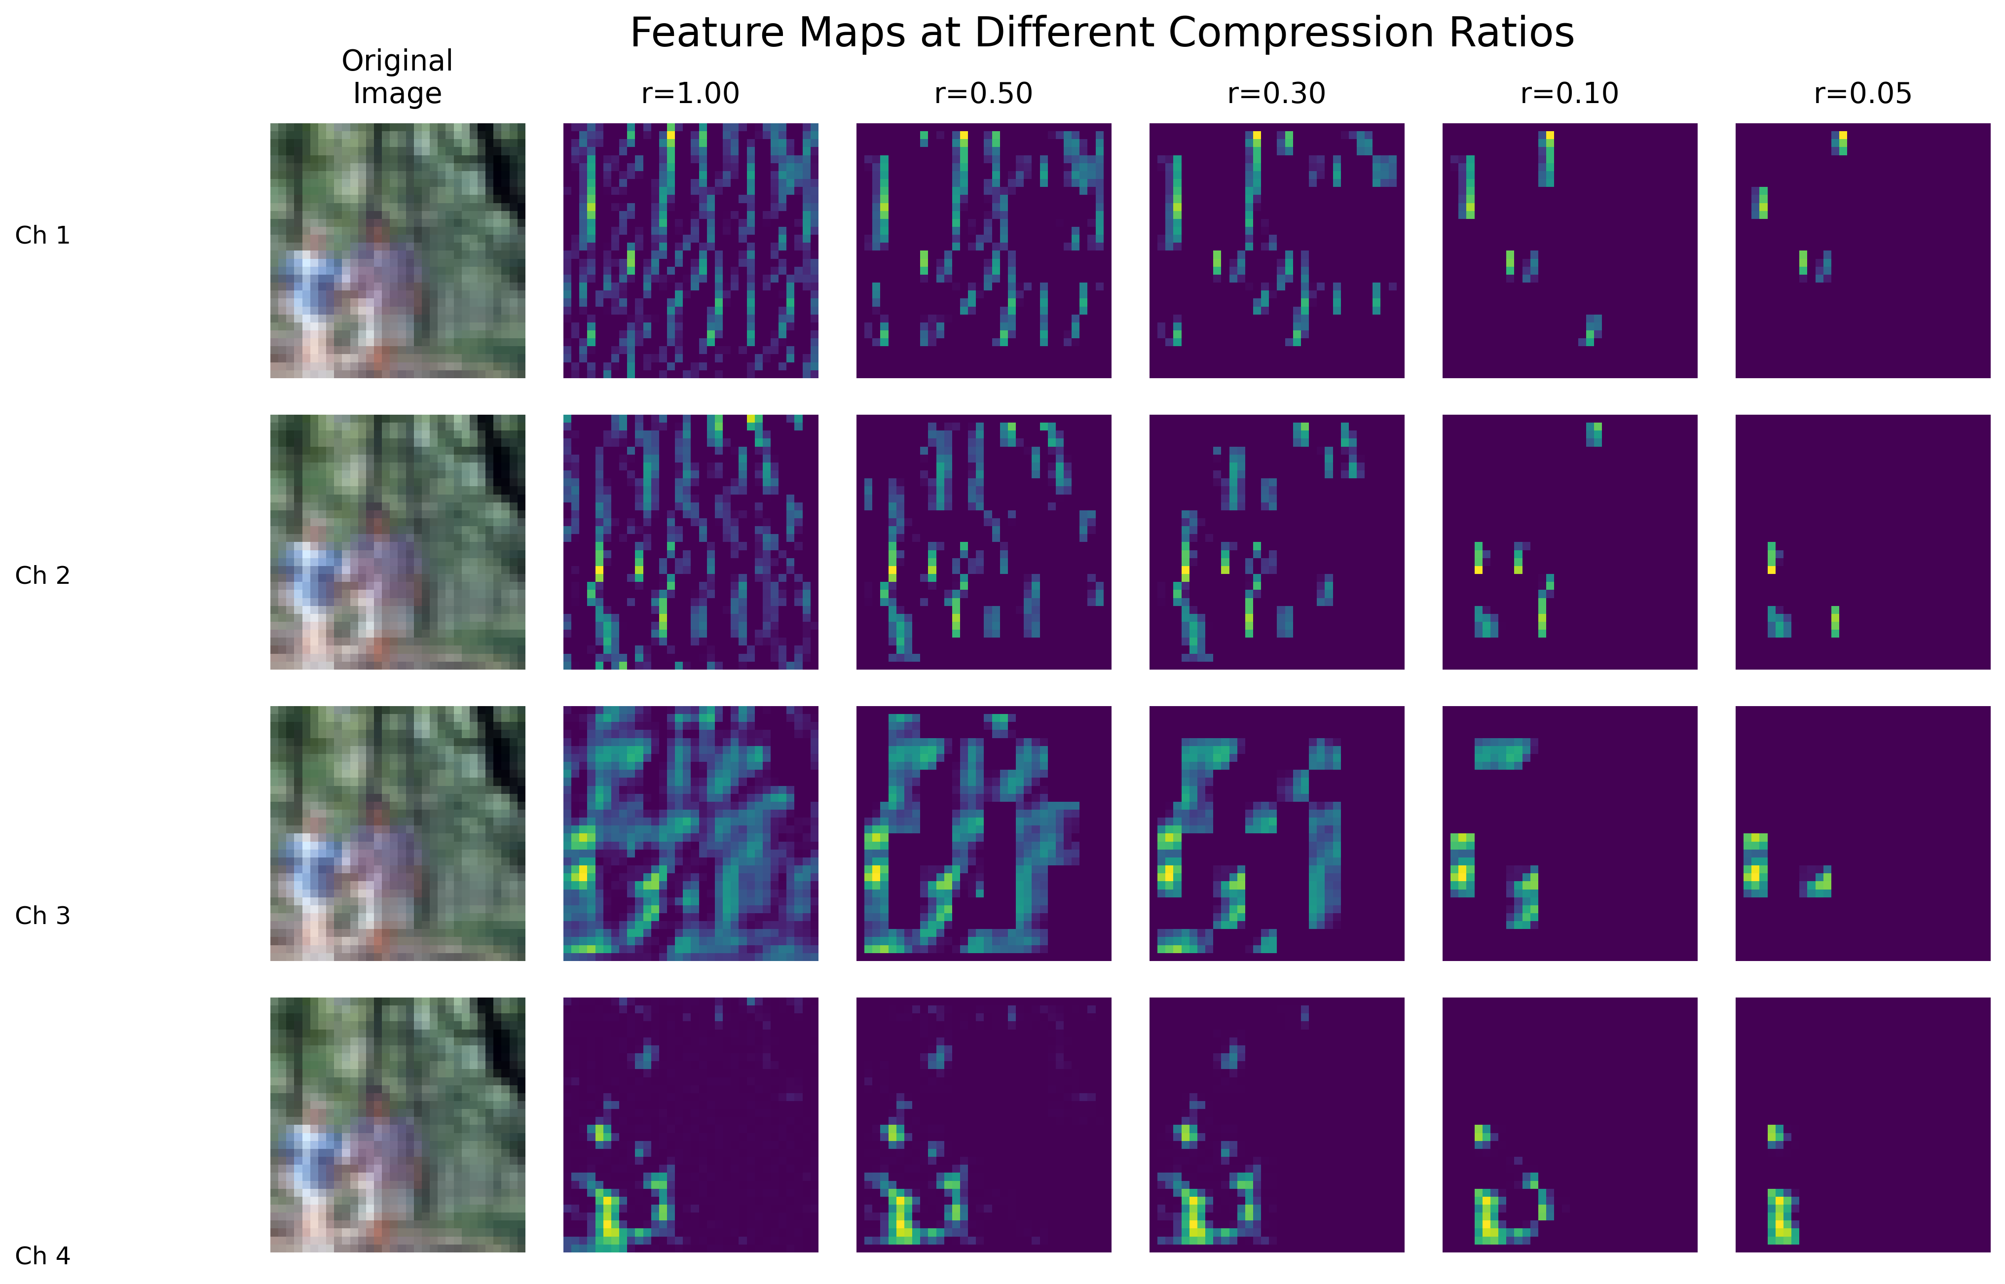

Slide 21
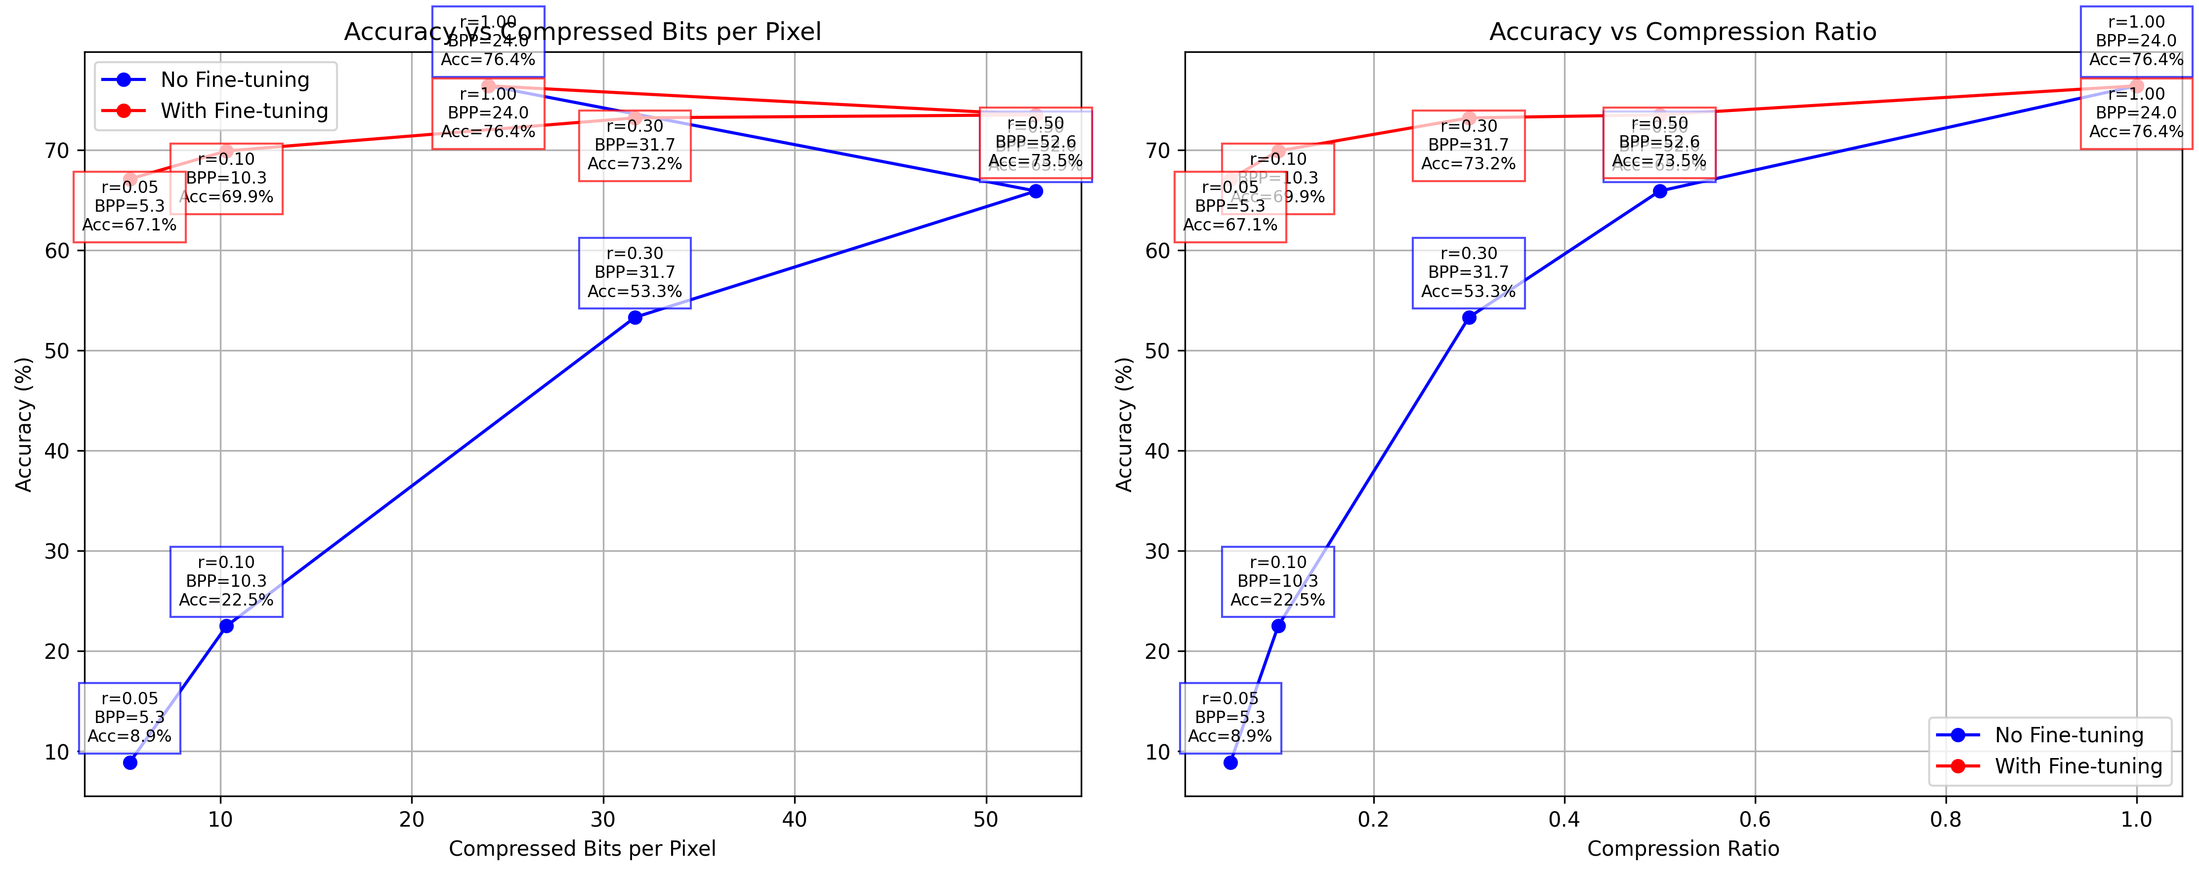

Slide 22
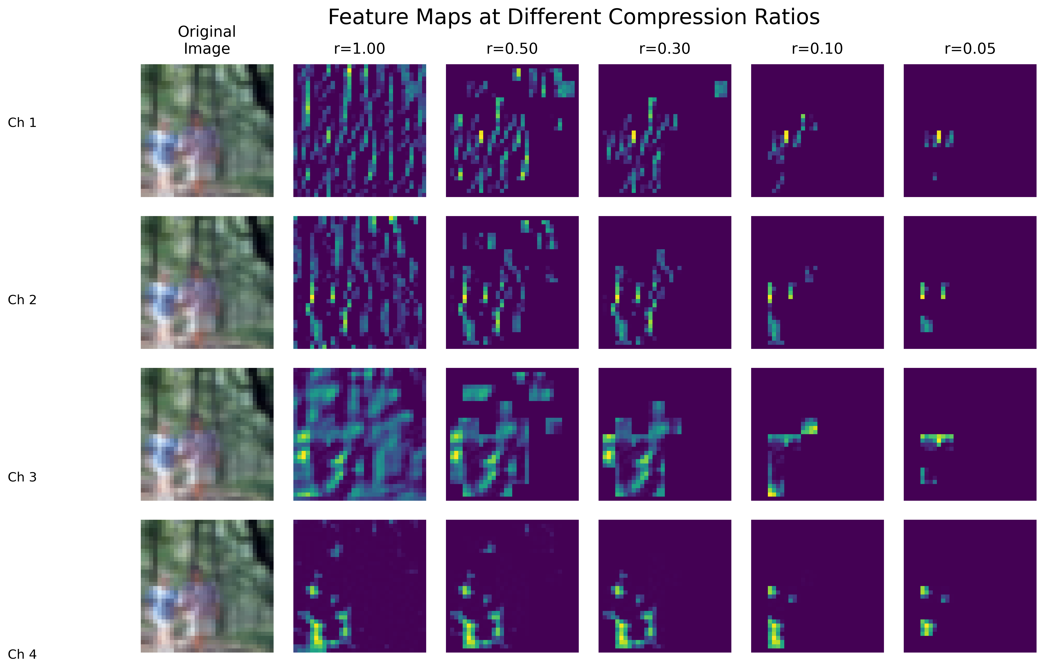

Slide 23
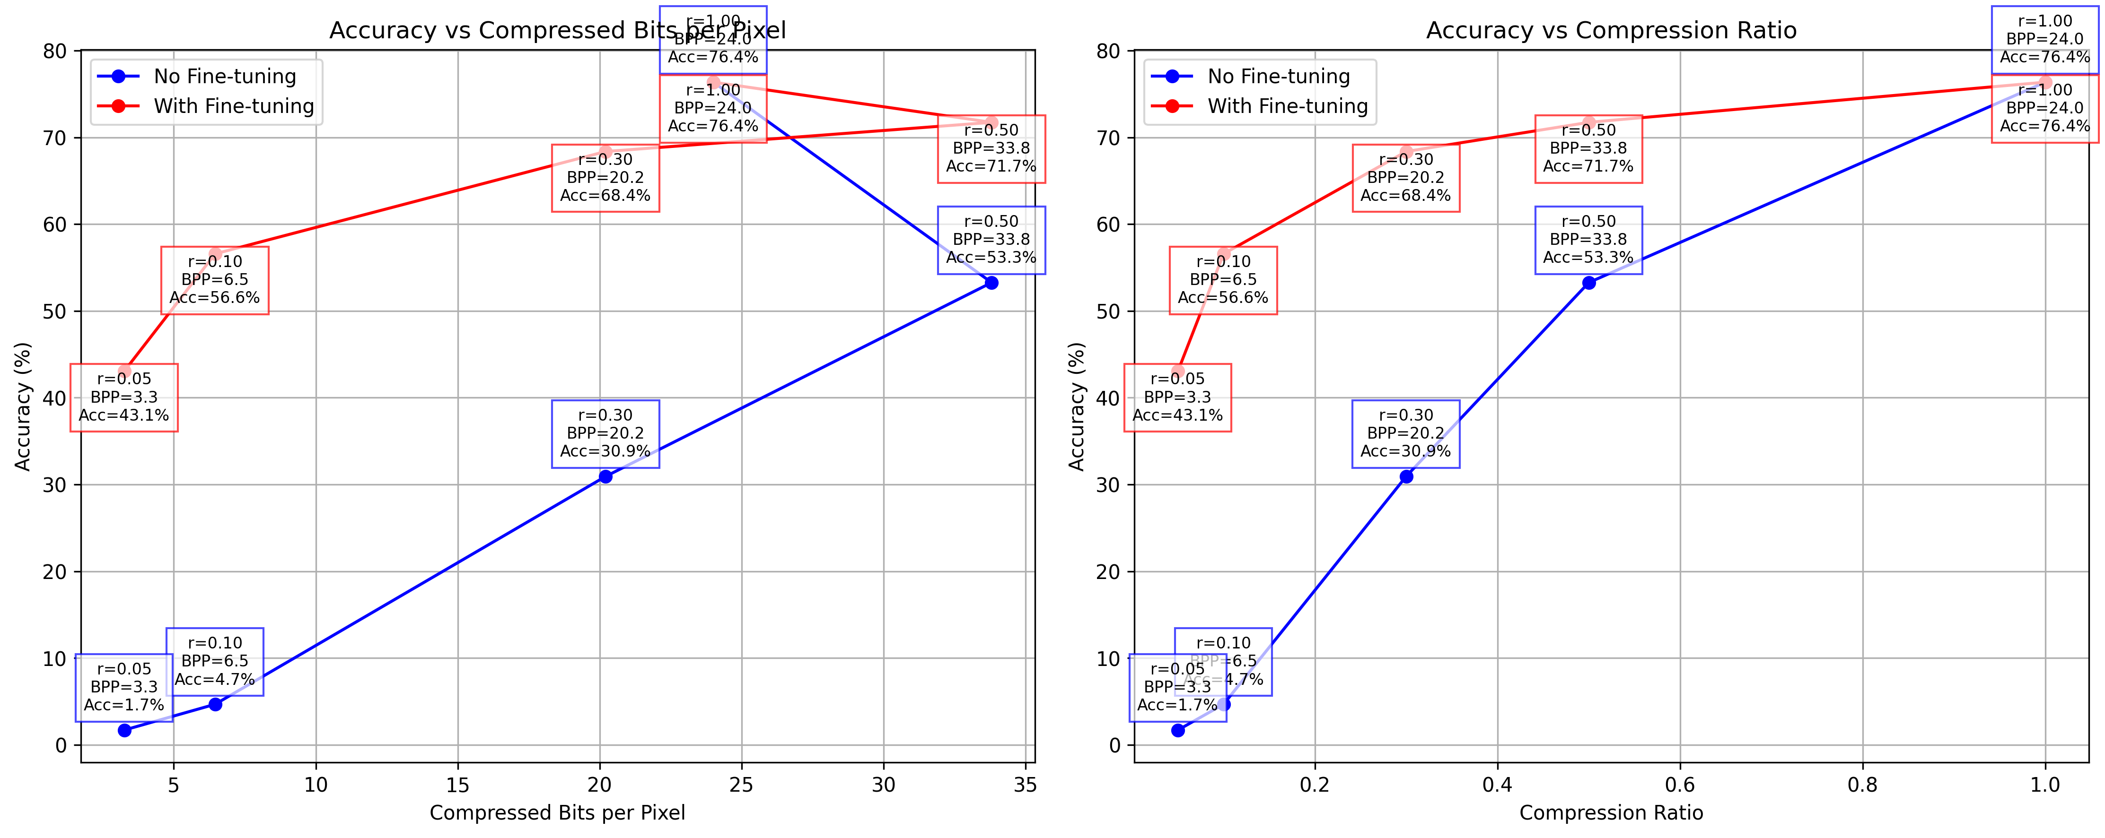

Slide 24
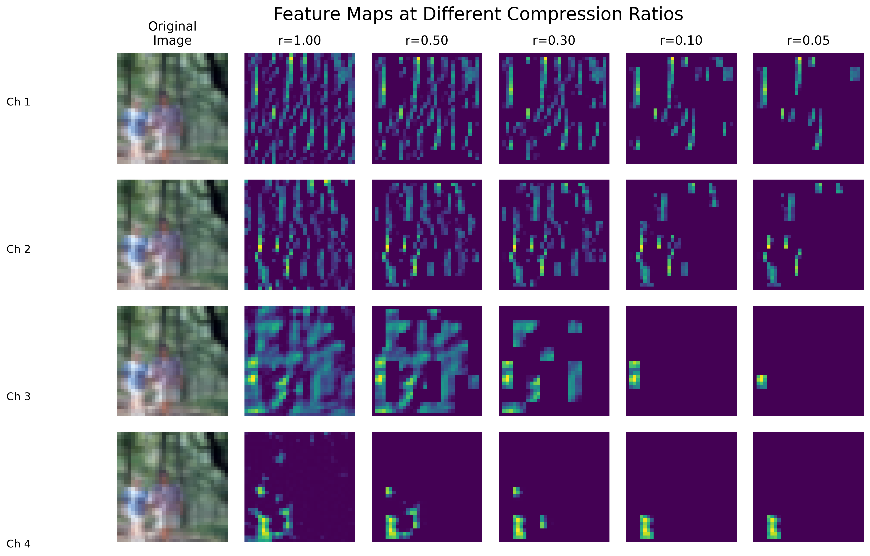

Slide 25
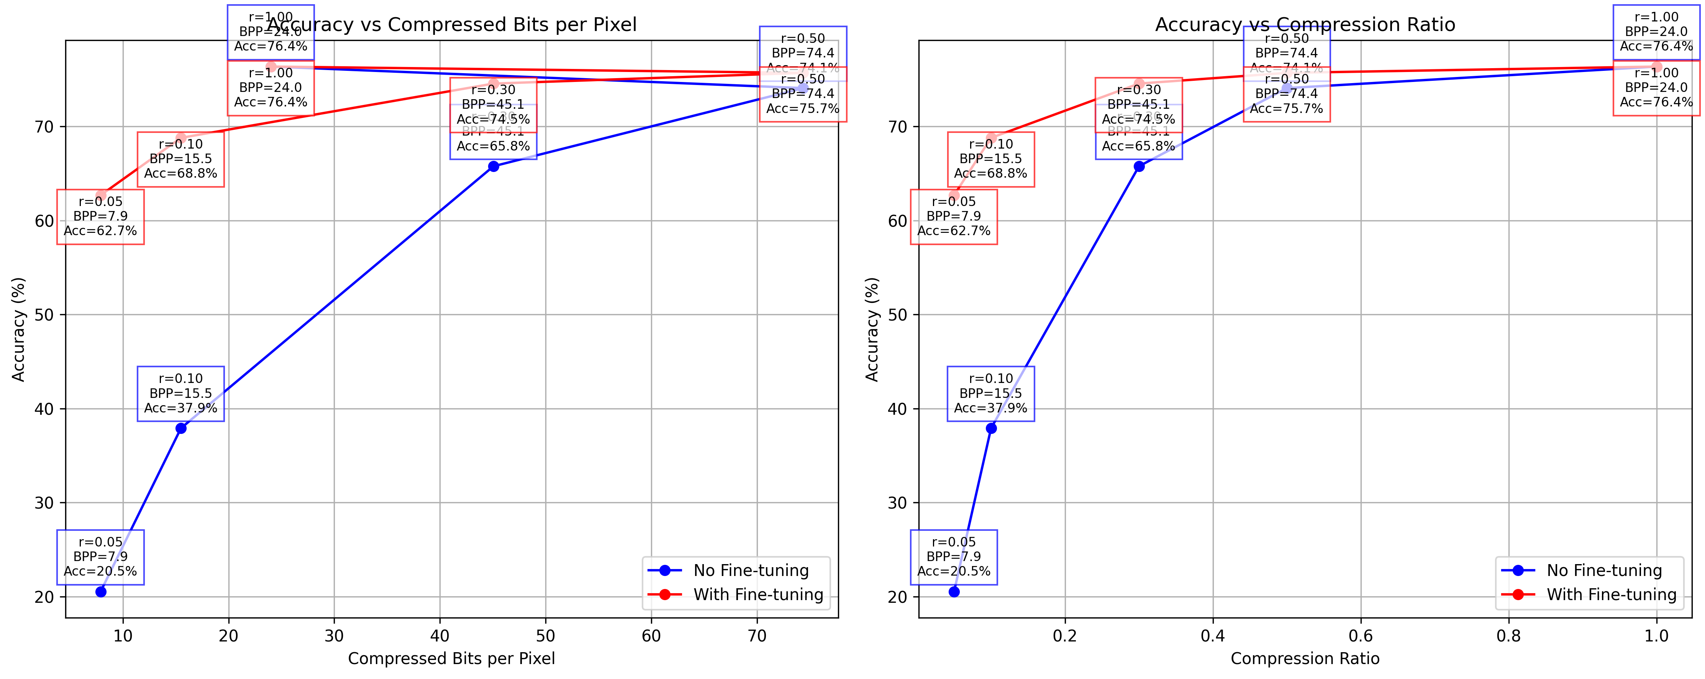

Slide 26
Run Cifar100 on ICM code

Slide 27
分工

Slide 28
Learning points

